Slide 1







SUPER STORE SALES DASHBOARD

Slide 2
GROUP MEMBERS
ALWIN KANNYAKONIL SCARIA C0894287 DONA BIJU C0894992 MOHAMMAD AFTAB C0891945 JERIN THENGUMPALLIL THOMAS C0896235 SNEHA SUJATHA C0908138 SANIKA SABEESH C0900949 TANVI TAKKAR C0907019

Slide 3





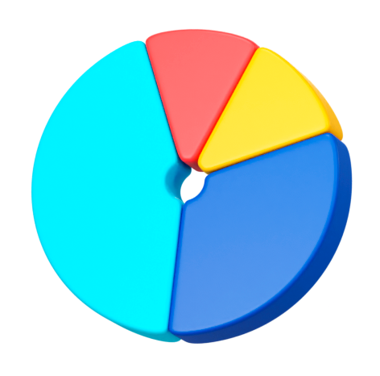






OVERVIEW
The Superstore sells a wide variety of products across various categories in the United States
This project analyses, visualizes and predicts based on the dataset.
Data Types
Float
Int
Object
23 Features
5901 Columns

Slide 4

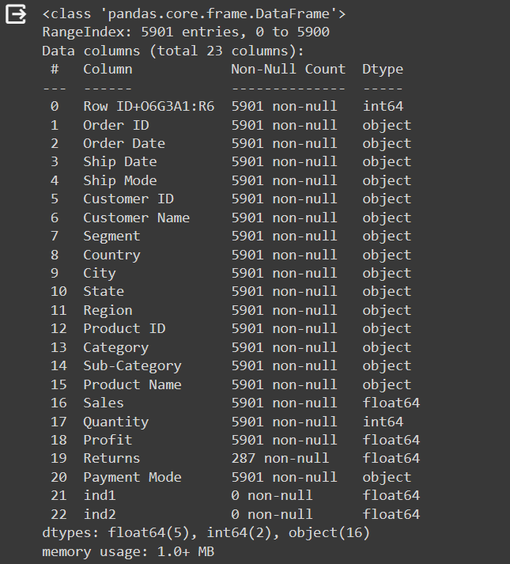
BASIC INFORMATION OF DATA FRAME

Slide 5








Technologies Used

Slide 6
PROJECT WORKFLOW
Data Pre-Processing
Data Visualization
Power BI Visualizations
Feature Engineering
Model Creation
Model Deployment
Flask App Creation

Slide 7
DATA VISUALIZATION
Histogram
Bar plot
Pie chart
matplotlib is used to plot distribution of sales by category such as Furniture, office supplies and technology
Seaborn is used to show distribution of sales
Seaborn is used to plot bar chart of Top 10 cities based on sales
Box plot
Count plot
Sub plot
Seaborn is used to plot shipmode and its count
Seaborn is used to plot box plot of each numerical column to see the outliers
matplotlib is used to show sales distribution of each sub category items

Slide 8
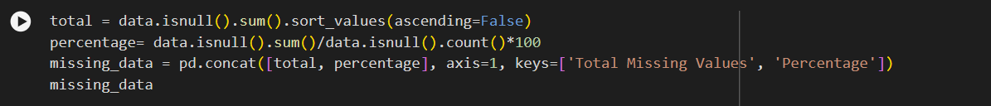
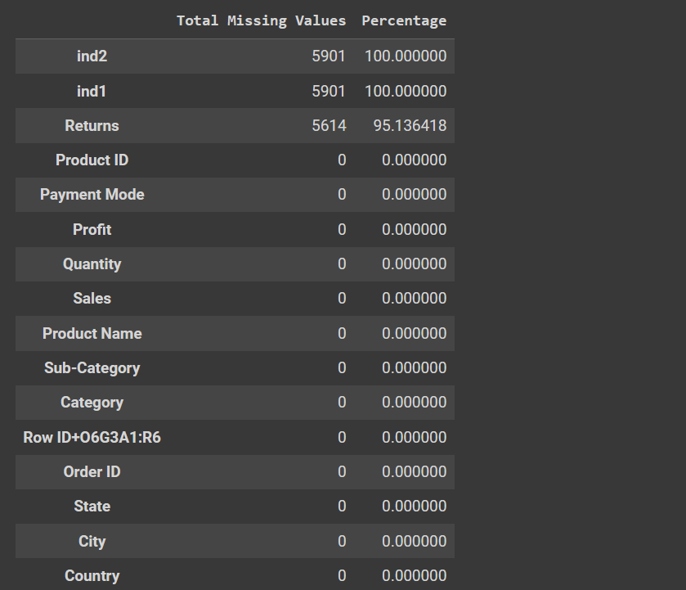
FINDING MISSING VALUES

Slide 9
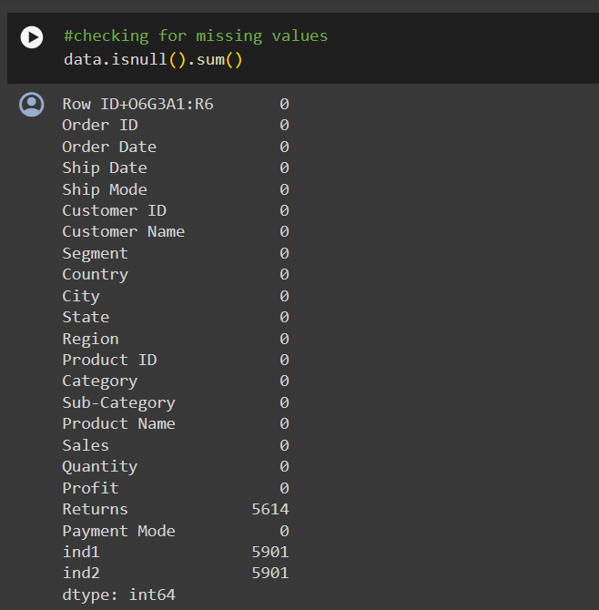
FINDING MISSING VALUES

Slide 10
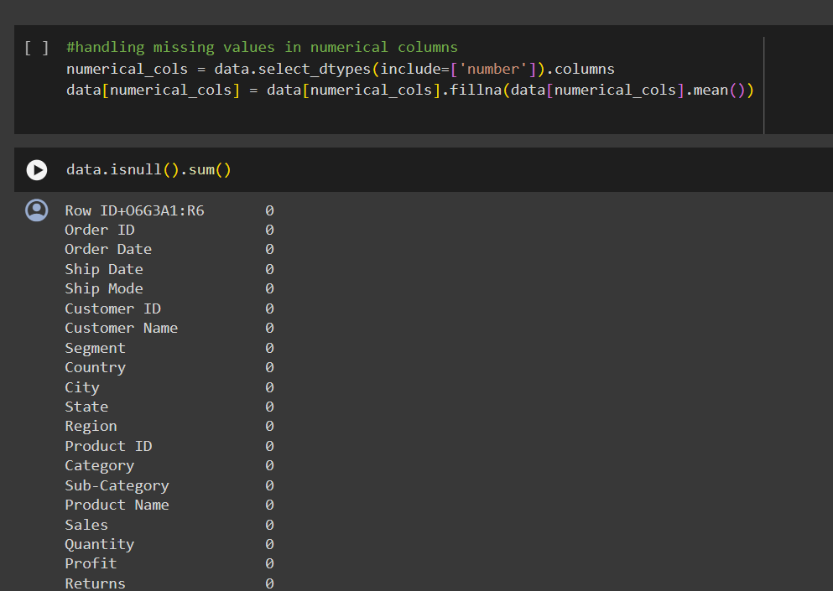
HANDLING MISSING VALUES

Slide 11
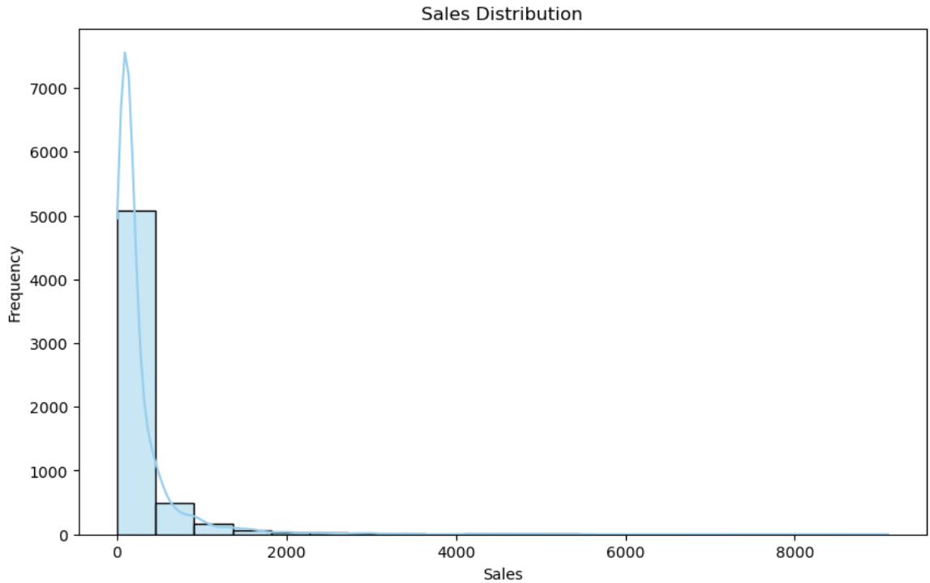
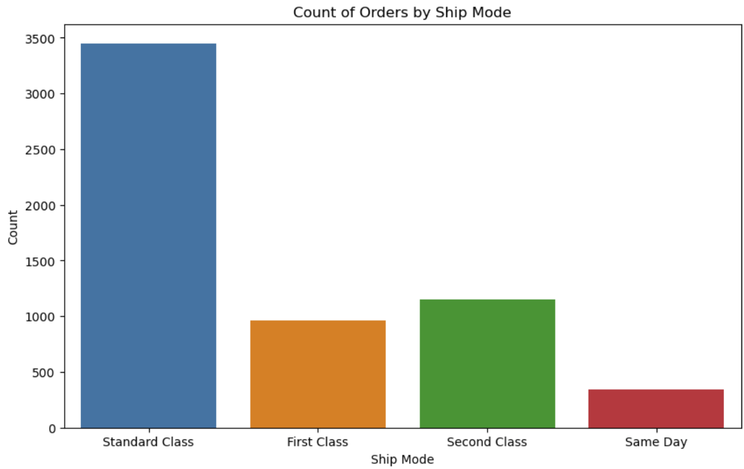
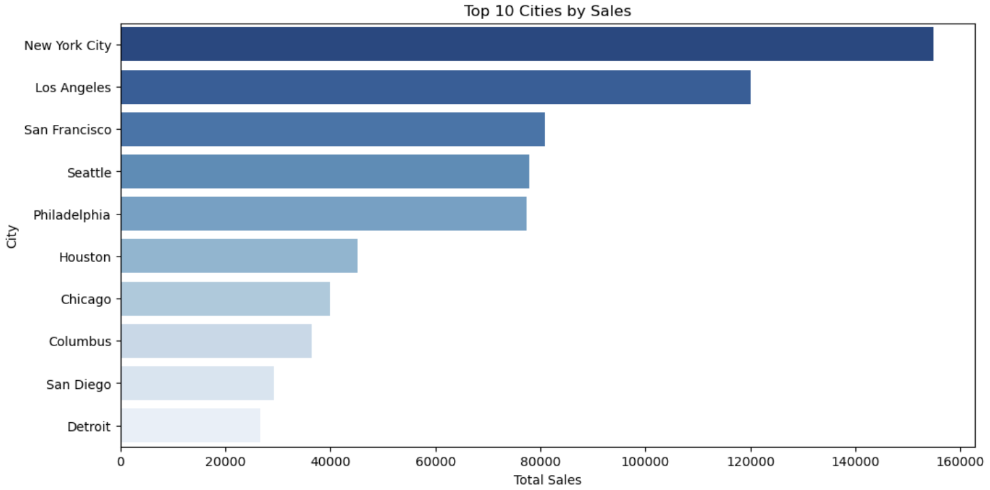
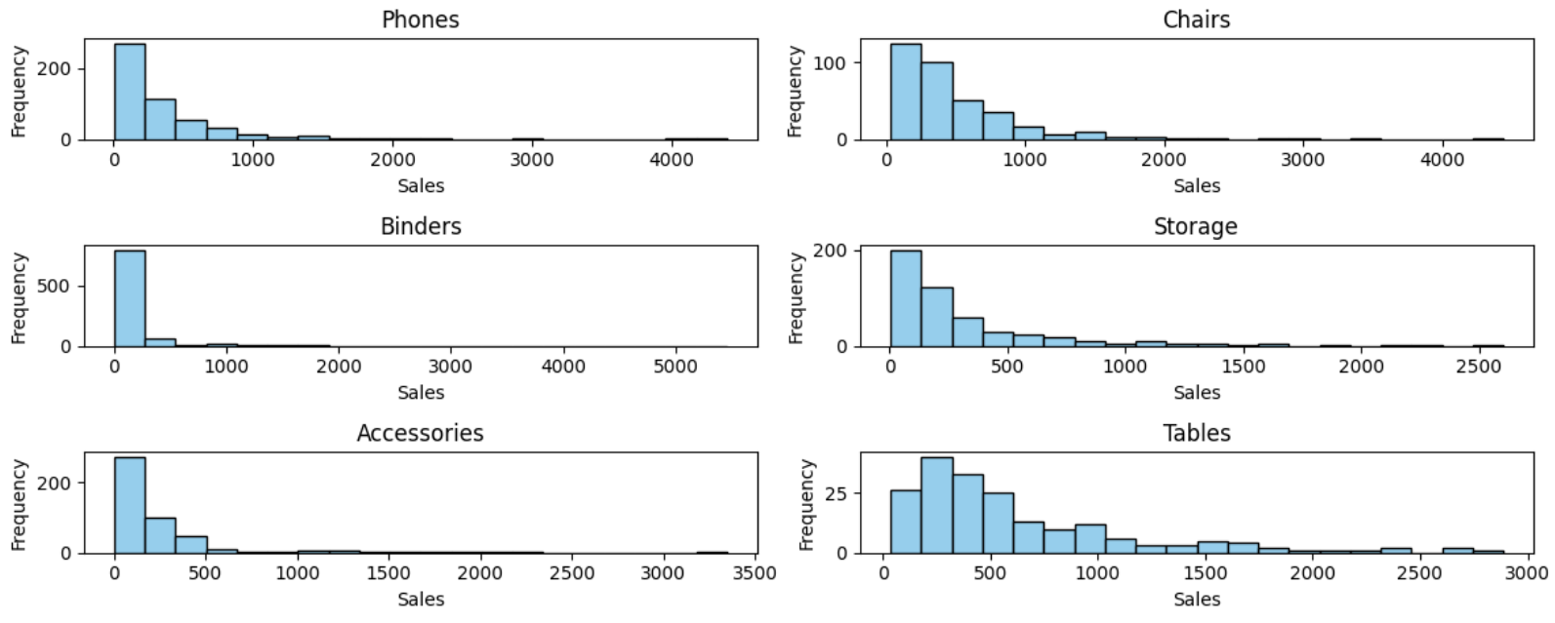
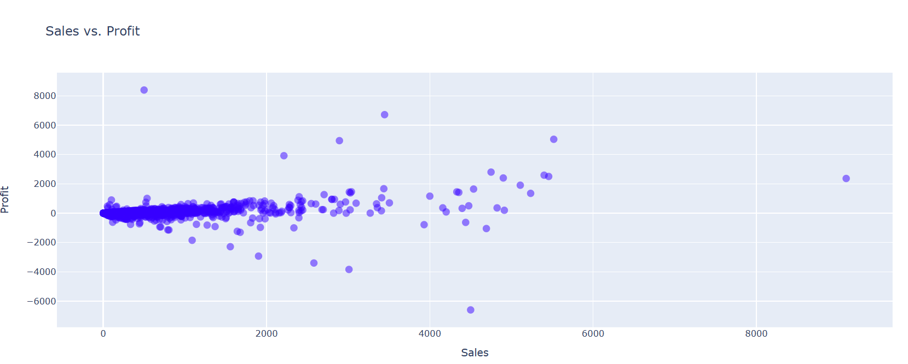
VISUALIZATION

Slide 12
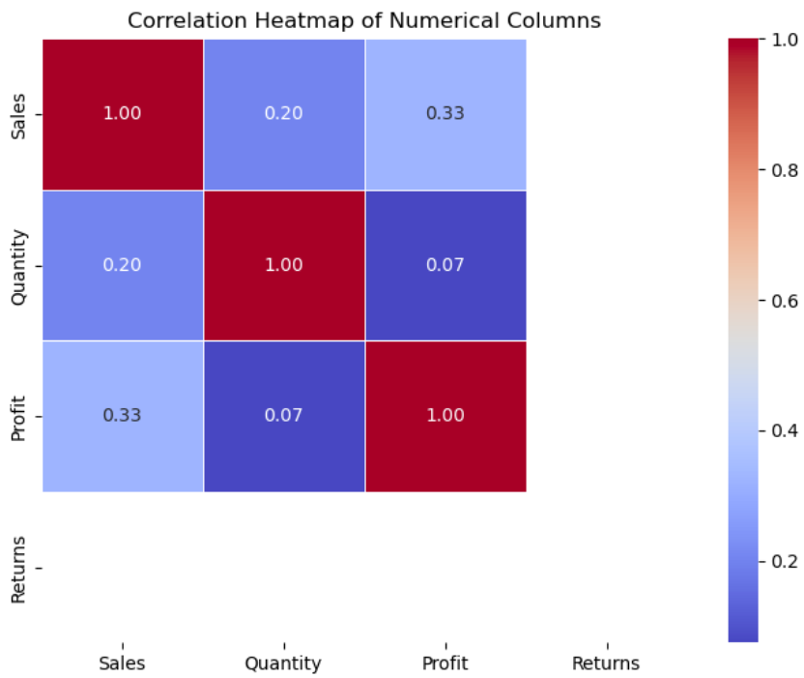
HEAT MAP

Slide 13
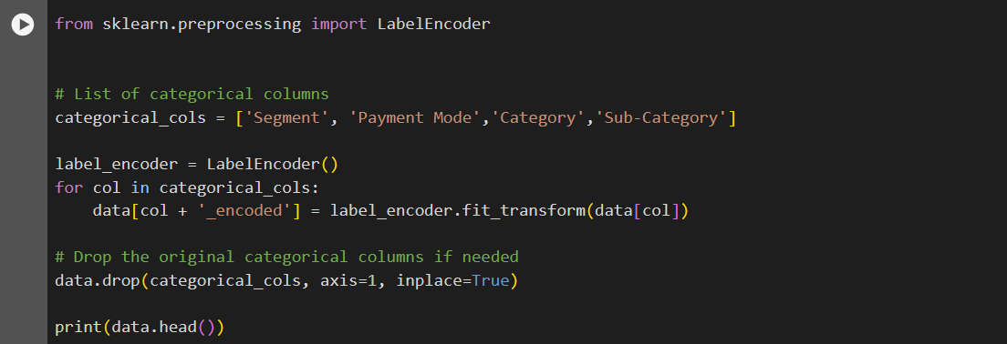
CONVERTING CATEGORICAL TO NUMERICAL

Slide 14
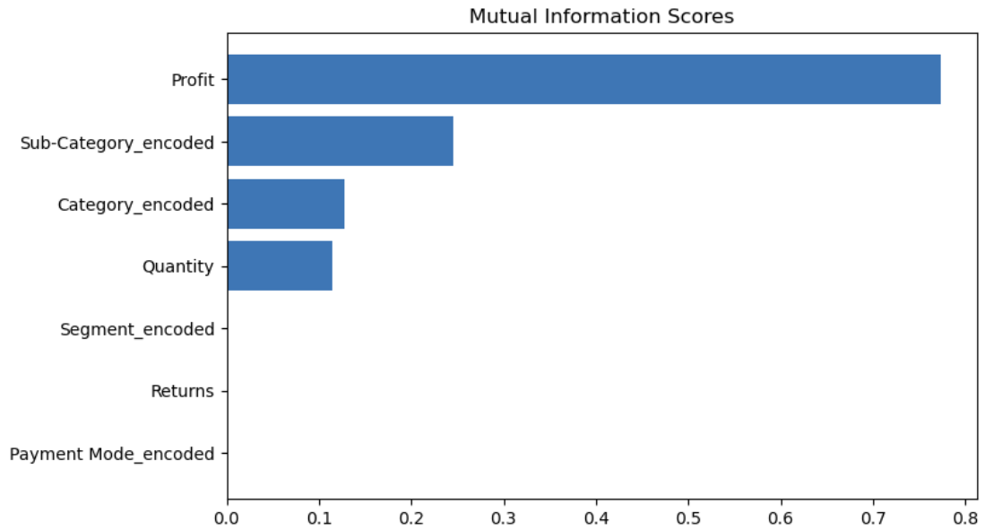
FEATURE IMPORTANCE FOR PREDICTING SALES

Slide 15
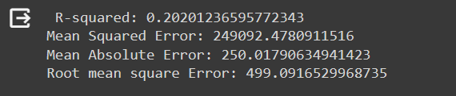
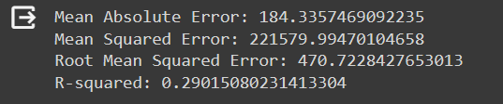
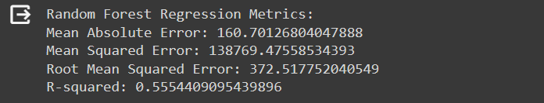
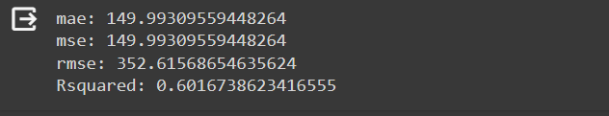
MODEL TRAINING AND EVALUATION
LinearRegression
DecisionTreeRegressor
RandomForestRegressor
RandomForest Using GridSearchCV

Slide 16
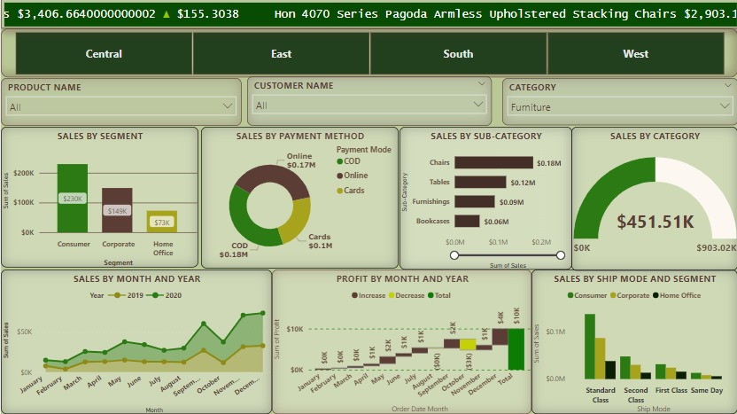
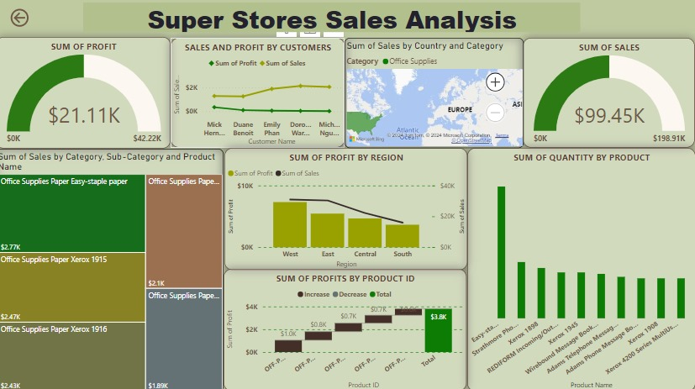
POWER BI DASHBOARD

Slide 17
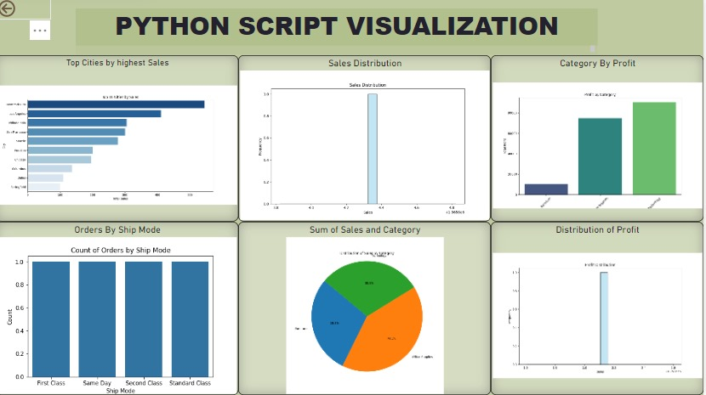

Slide 18

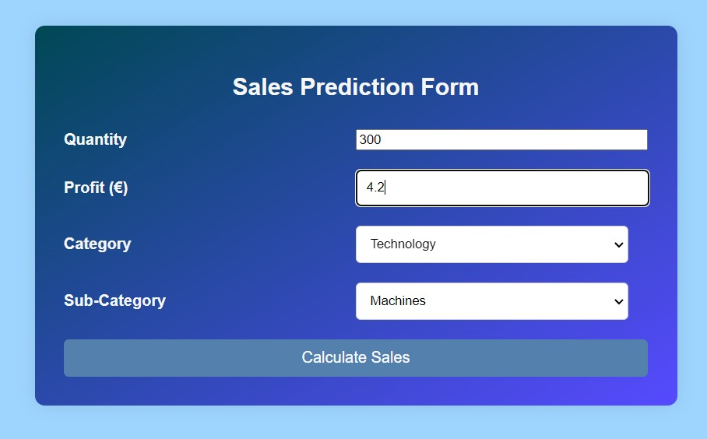
DEPLOYMENT

Slide 19
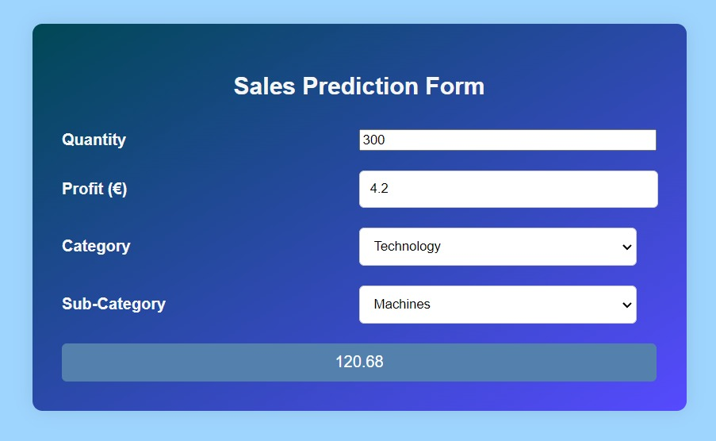

Slide 20


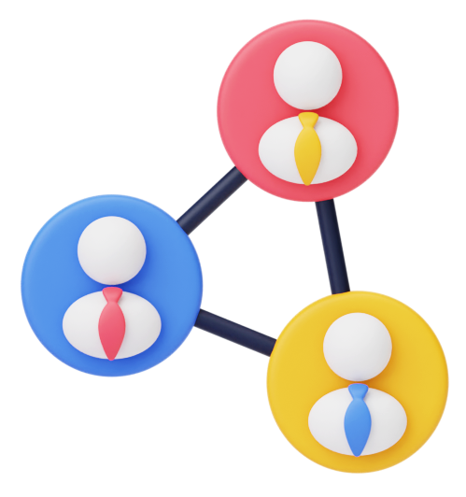





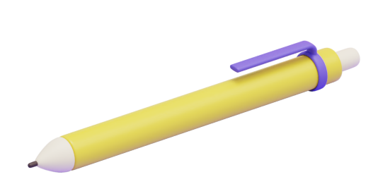
THANK YOU !

